Slide 1


Using Phyton and SQL for Data Manipulation
Kamran Suleyman

Slide 2
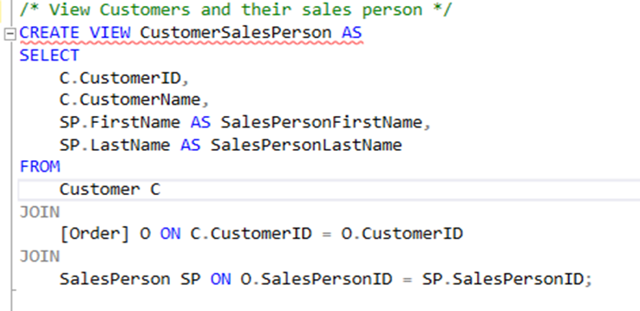
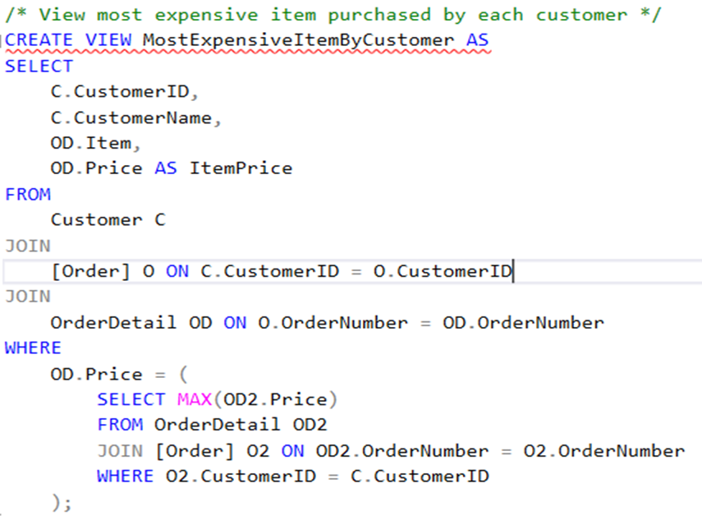
SQL Views
Objective: This view displays each customer along with the sales person assigned to their orders.
Explanation:
Customer C: Represents the Customer table as "C".
JOIN [Order] O ON C.CustomerID = O.CustomerID: Links customers to their orders.
JOIN SalesPerson SP ON O.SalesPersonID = SP.SalesPersonID: Connects each order to the corresponding sales person.
Objective: This view shows the most expensive item each customer has purchased.
Explanation:
JOIN OrderDetail OD ON O.OrderNumber = OD.OrderNumber: Links each order to its detailed items, including prices.
Subquery:
WHERE OD.Price = (SELECT MAX(OD2.Price) ...): The subquery finds the highest Price for each customer.
For each customer, only the item with the maximum price is returned.

Slide 3
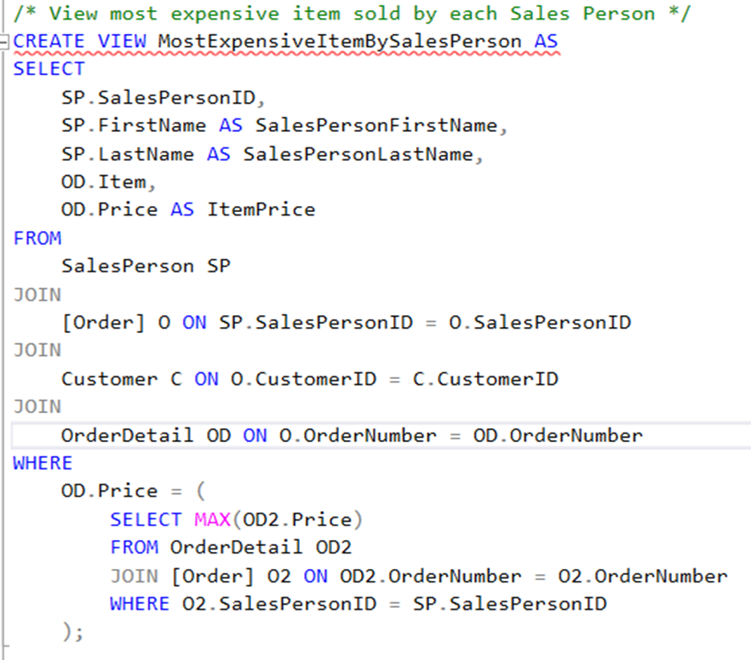
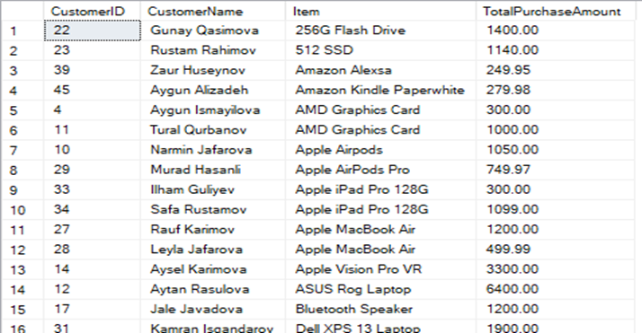
SQL Views
· Objective: This view lists each salesperson and the highest-priced item they have sold.
· Explanation:
·JOIN [Order] O ON SP.SalesPersonID = O.SalesPersonID: Connects each salesperson to their respective orders.
·JOIN OrderDetail OD ON O.OrderNumber = OD.OrderNumber: Links each order to the individual items sold within it.
·Subquery:
oWHERE OD.Price = (SELECT MAX(OD2.Price) ...): The subquery finds the highest price among the items sold by each salesperson.
oThis ensures that only the most expensive item for each salesperson is displayed.
CONTINUE

Slide 4
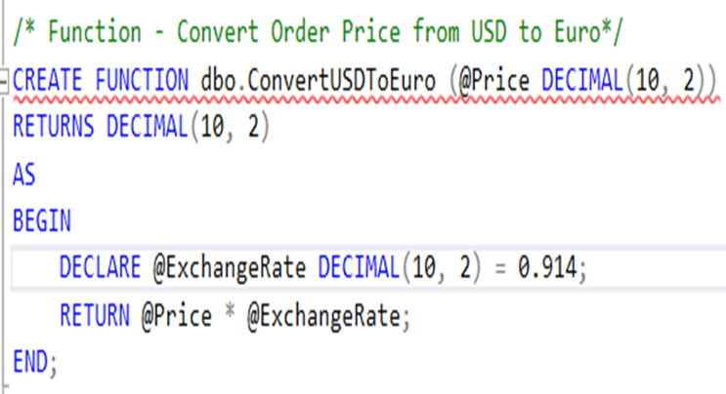
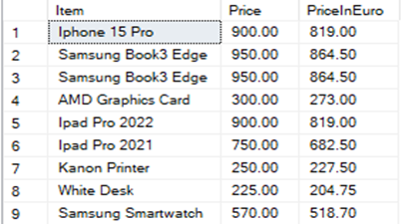
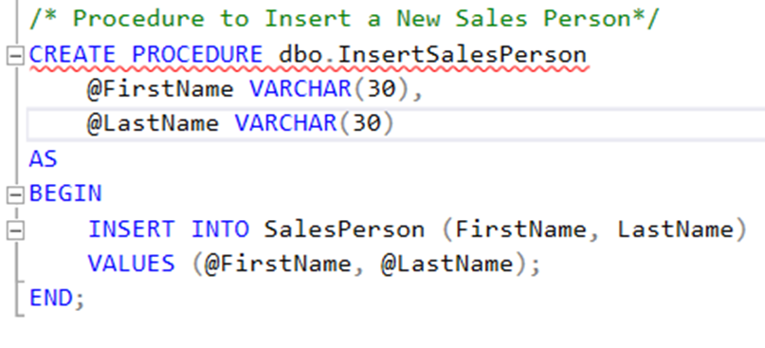
SQL Function and Procedures
Code Explanation
•dbo.ConvertUSDToEuro is the function name.
•@Price is an input parameter representing the price in USD, and it is specified as a DECIMAL(10, 2) type, which can store up to 10 digits, with 2 decimal places.
•The function will return a DECIMAL(10, 2) value. In this case, it’s the converted Euro price.
•BEGIN and END define the function’s body.
•Inside the function, a local variable @ExchangeRate is declared, set to 0.914. This rate represents the hypothetical conversion rate from USD to Euro.
•The function then multiplies @Price by @ExchangeRate to calculate the converted Euro amount and returns it.
Code Explanation​
dbo.ConvertUSDToEuro is the function name.
CREATE PROCEDURE dbo.InsertSalesPerson defines a new stored procedure named InsertSalesPerson in the dbo schema. Stored procedures are reusable SQL code blocks that can perform specific operations in the database.
The parameters @FirstName and @LastName, each of type VARCHAR(30), represent the first and last names of the salesperson to be inserted.
BEGIN and END define the function’s body.
The INSERT INTO SalesPerson (FirstName, LastName) VALUES (@FirstName, @LastName); line inserts a new record into the SalesPerson table, using the values provided for @FirstName and @LastName.

Slide 5
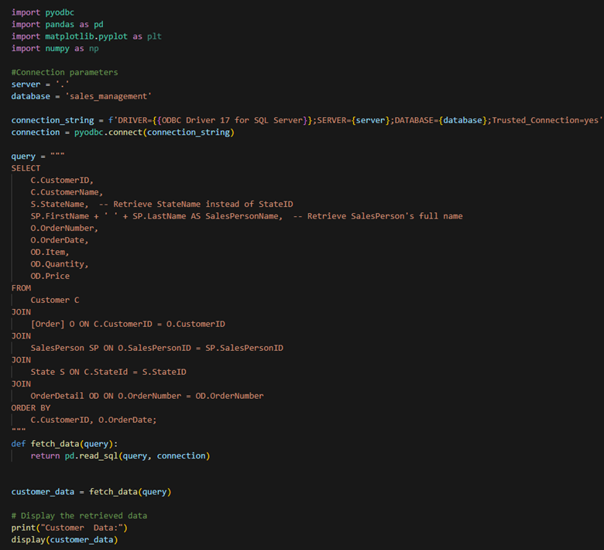
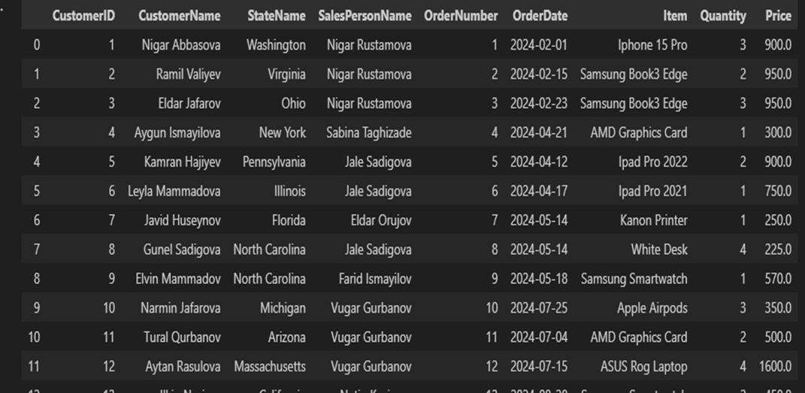
Retrieving data from Database
Code Explanation
· Libraries:
·pyodbc: For connecting to the SQL Server database.
·pandas: To fetch and structure data as a DataFrame.
·matplotlib.pyplot and numpy: Useful for visualizations if data needs to be plotted.
· SQL Query Execution in Python:
Combines SQL and Python for efficient data manipulation and retrieval.
Simplifies complex database queries and displays data in Python for further analysis or visualization.

Slide 6
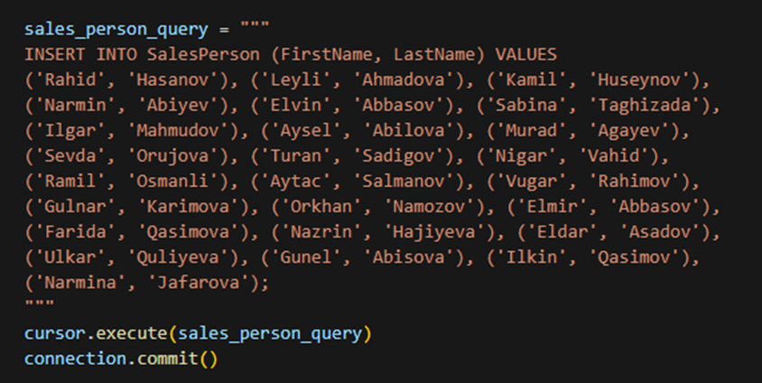
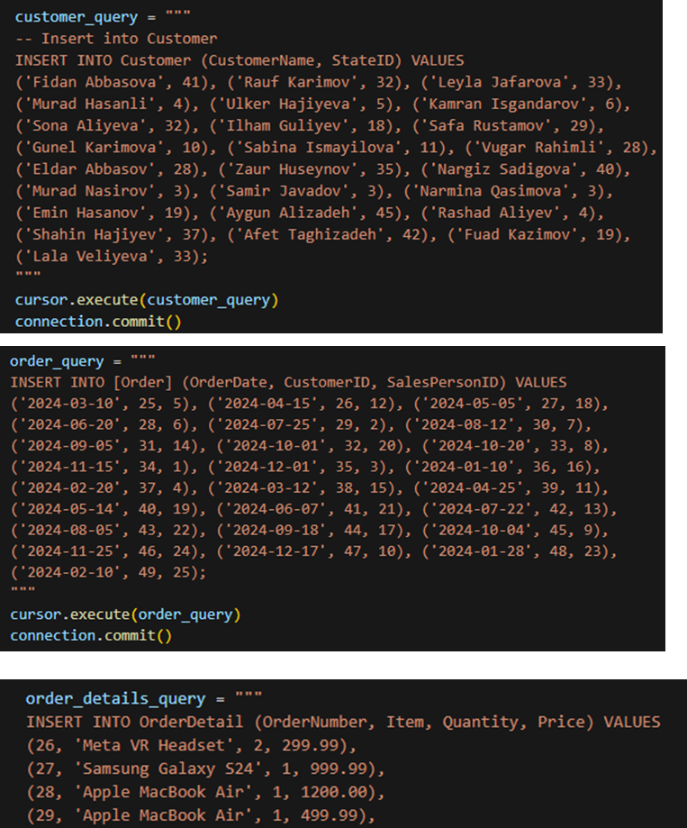
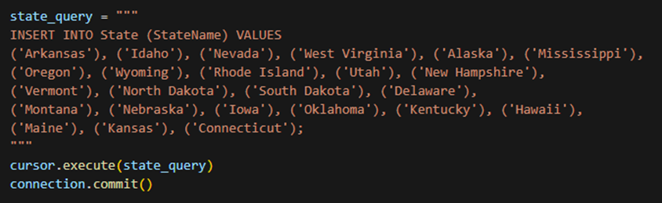
Inserting Data to Database using Python
Code Explanation
Execute Insertion: cursor.execute(customer_query) runs the previously defined customer_query SQL command, inserting customer records. Then, connection.commit() saves these changes to the database.

Slide 7
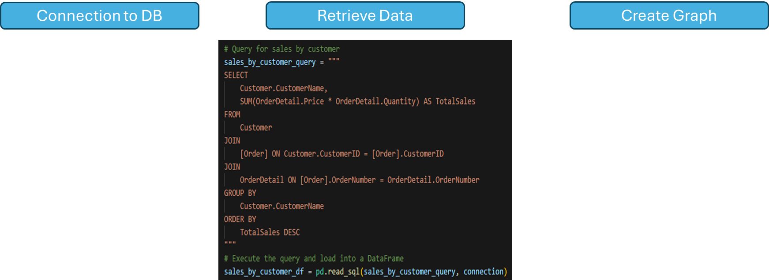
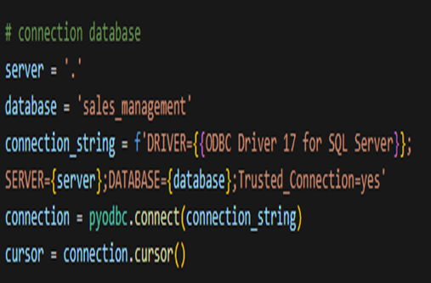
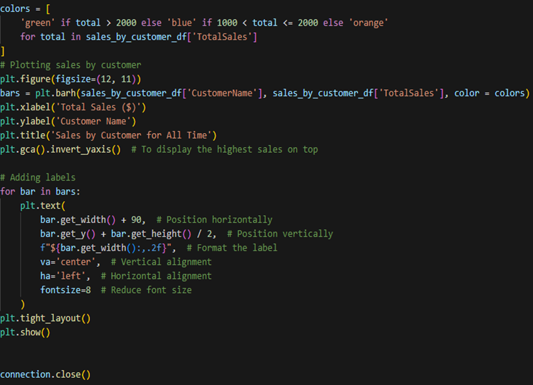
Phyton Code - Sales by Customer
Code Explanation
Loading and Processing Data: The query joins three tables: Customer, Order, and OrderDetail to retrieve each customer's name and calculate their total sales.
Loading data into DataFream : pd.read_sql(sales_by_customer_query, connection) executes the SQL query and loads the results into a Pandas DataFrame
Plotting: creates a horizontal bar chart where each customer's name is on the y-axis and their total sales on the x-axis.

Slide 8
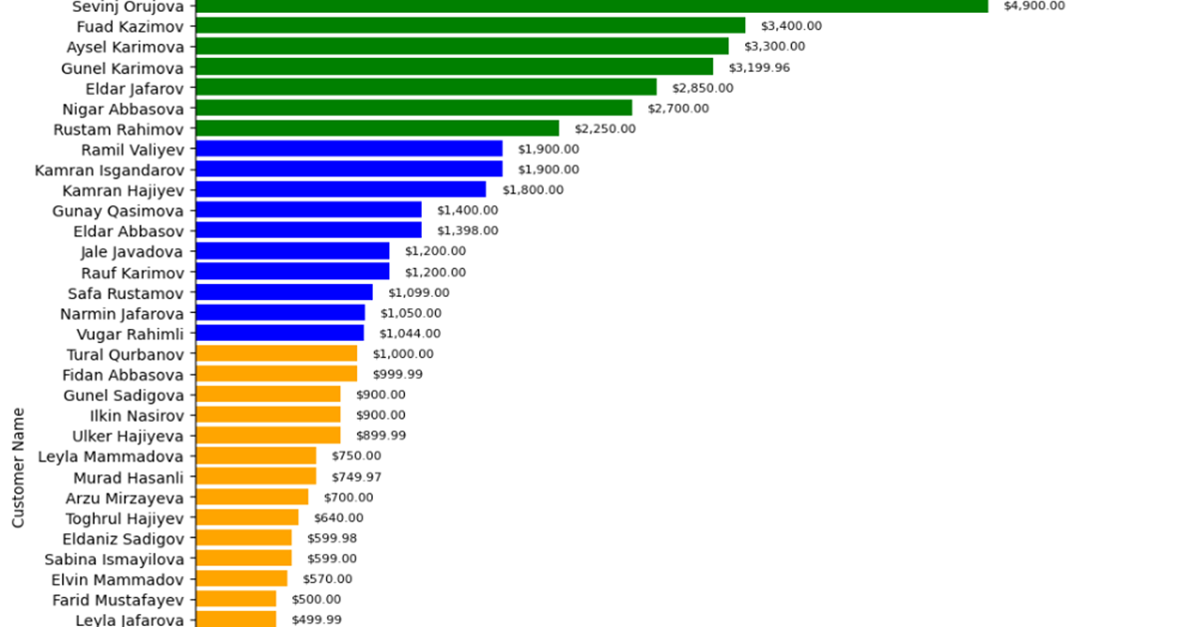
Graph – Showing Total Sales per Customer
Graph Explanation
This bar chart visualizes Sales by each customer for all time. Here’s a breakdown of the key elements and features in the graph:
1.Customer Names on the Y-axis:
Each bar represents a unique customer, whose name is displayed along the y-axis.
2.Total Sales on the X-axis:
The x-axis shows the total sales amount in dollars for each customer.
15%
Business
Graphic

Slide 9
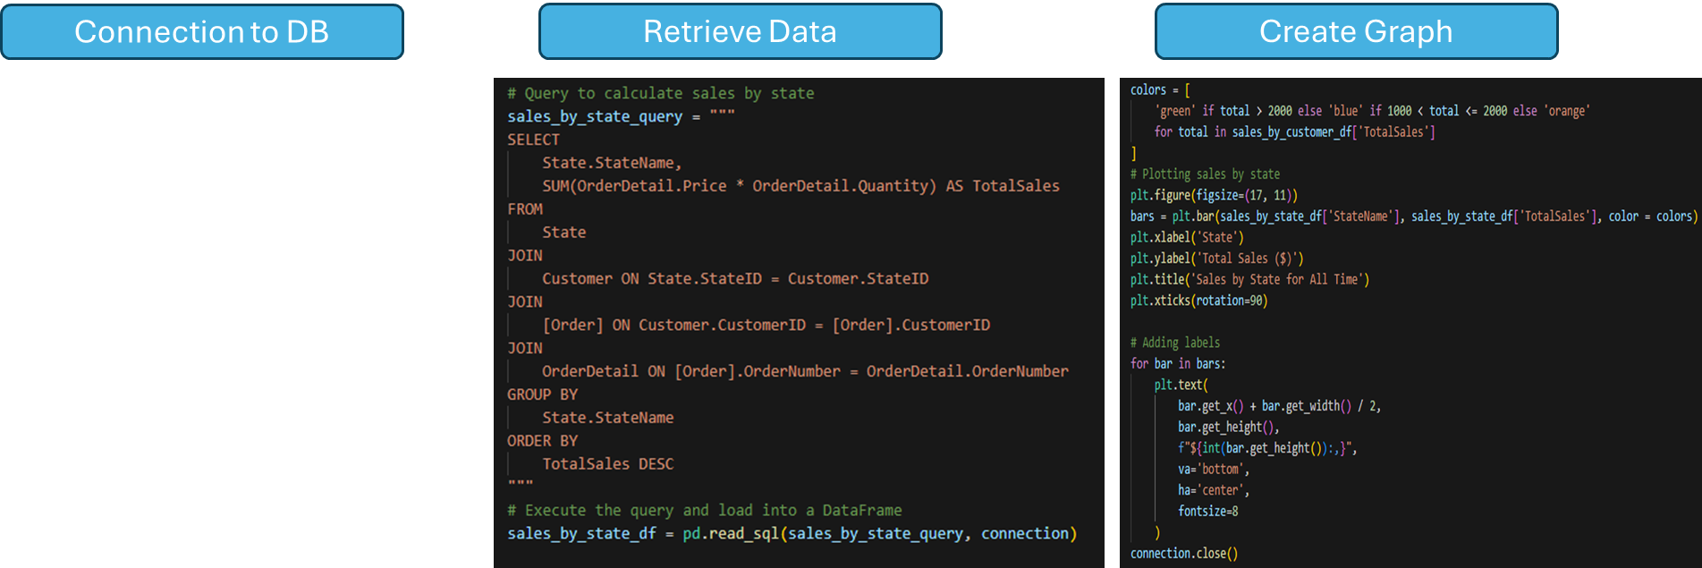
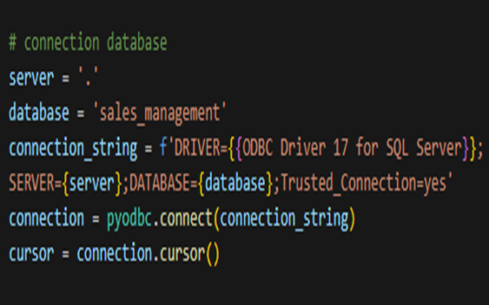
Phyton Code - Sales by States
Code Explanation
Loading and Processing Data: The query joins the State, Customer, Order, and OrderDetail tables to ensure each sale is associated with a customer and their state.
Loading data into DataFream: The results are loaded into a Pandas DataFrame, sales_by_state_df, for further processing and visualization.
Plotting: Bar chart with state names on the x-axis and total sales on the y-axis is created using matplotlib.

Slide 10
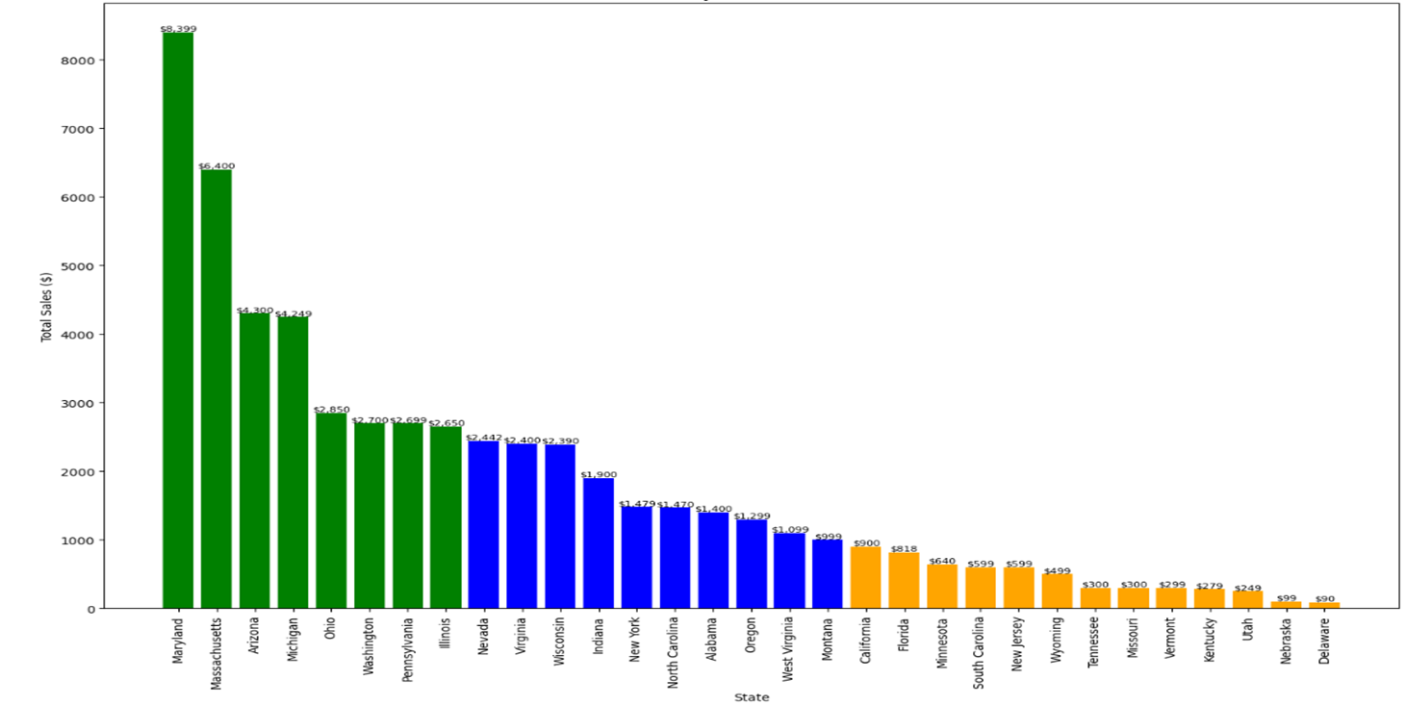

Graph – Showing Total Sales per State
Graph Explanation
This bar chart visualizes Sales by states for all time, displaying each state total sales.
- key elements and features in the graph:
1.Total sales on the Y-axis:
The y-axis shows the total sales amount in dollars for each state.
2.Sate names on the X-axis:
Each bar represents a unique state, displayed along the x-axis.
Contact Us
+123 456 7890

Slide 11

THANK YOU

